Slide 1
NETFLIX MOVIES AND TV SHOWS ANALYSIS
Gauri Gupta
Tanya Qader
Anjali Sagar

Slide 2
agenda
Introduction
Objective and description
Data cleaning and exploration
Detailed slide presentation
Questions

Slide 3
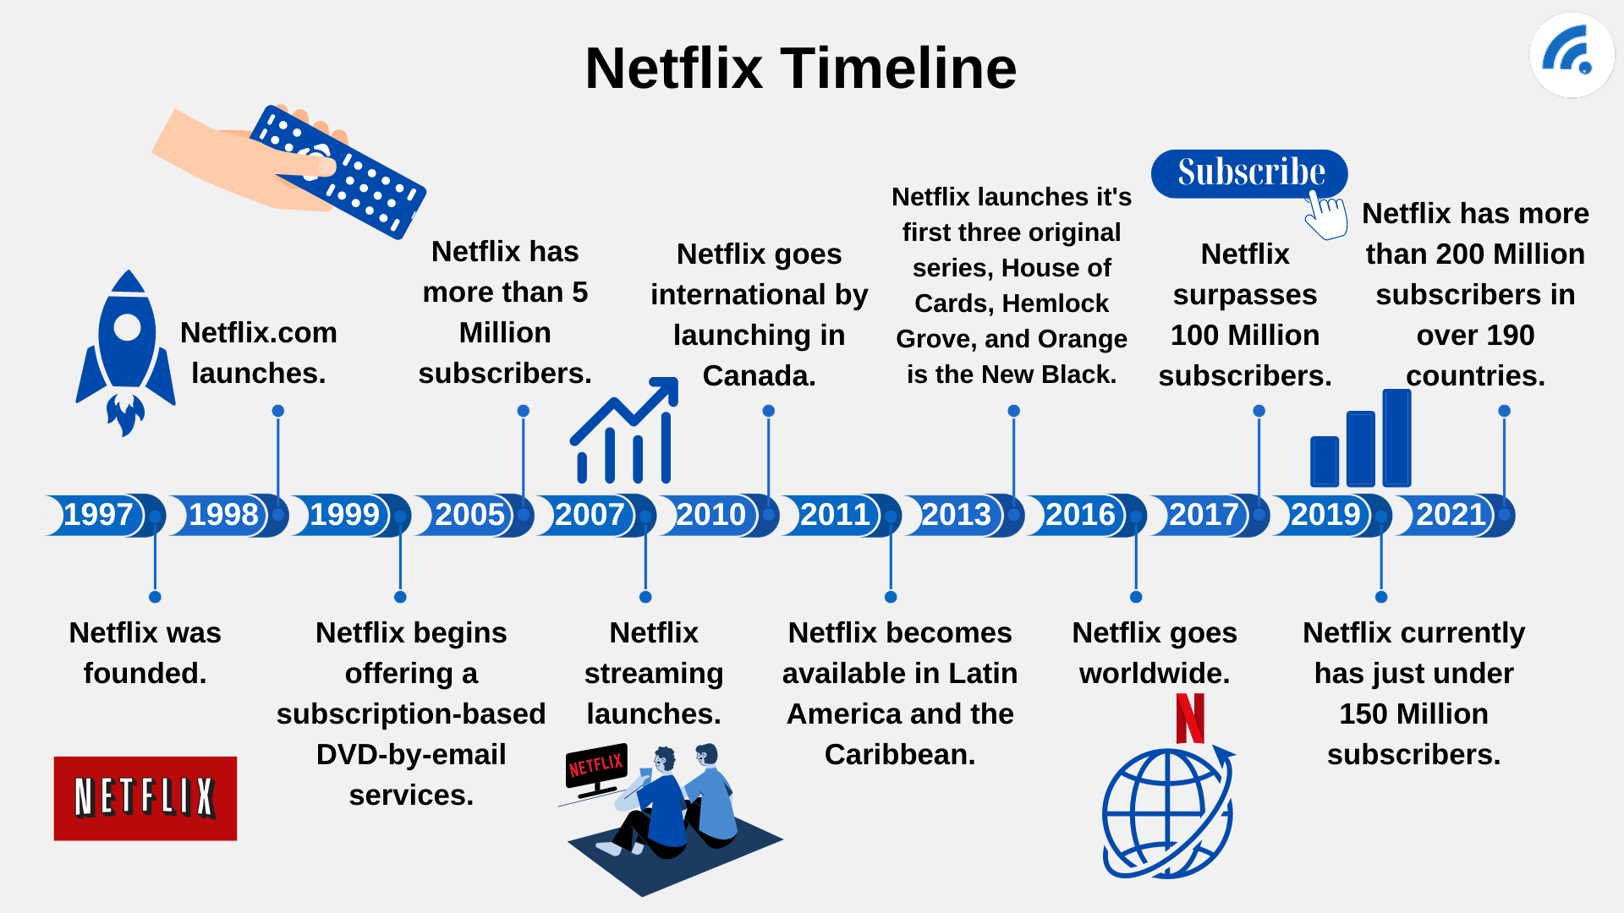
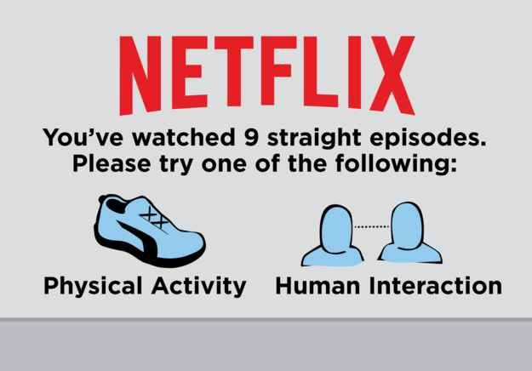
Introduction
As of 2022, Netflix has 220.67 million subscribers and is available in 190 countries.
Netflix started with only 1000 titles and by 2016 there were 2400 titles originally produced.
About 12.6% of the world’s bandwidth is consumed by Netflix

Slide 4
objective and description of the project
Objective – Generate insights on Netflix content.
How – By processing the dataset which is sourced from Kaggle.com and using various data exploration techniques.
Project tasks-
Project Proposal – Link
Data source- Kaggle.com
Data cleaning and Exploration -
Data Visualization
Data insights
GitHub Management
Conclusion

Slide 5
Data Cleaning and exploration
Data challenges and limitations
Data available is from content added between 2008 and 2020.
Partial data available for 2020.
Missing data attributes like IMDB ratings.
Data cleaning :
Reviewed data frame statistics periodically to identify data issues.
Column with null values is removed to make data more presentable and readable.
Formats have been changed for columns ‘duration’ and ‘date added’.
Removed spaces via strip function few columns.
Enhanced data by extracting IMDB ratings from OMDB API. Limited by 1,000 api calls per day
Data exploration:
We have used Matplotlib and Seaborn to create pie charts and plots.

Slide 6
questions
WHAT TYPE OF CONTENT IS AVAILABLE ON NETFLIX
WHAT ARE THE MOST POPULAR GENRE ON NETFLIX
HOW HAS NETFLIX CONTENT GROWN OVER THE YEARS?
WHICH COUNTRY HAS THE HIGHEST NUMBER OF TITLES ON NETFLIX?
WHAT ARE THE MOST POPULAR MATURITY RATING ON NETFLIX?
WHAT ARE THE MOST POPULAR MATURITY RATING ON NETFLIX?
TOP 10 HIGHEST/LOWEST-RATED TITLES BASED ON IMDB RATING

Slide 7
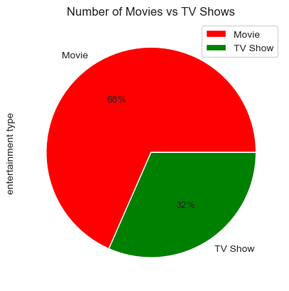
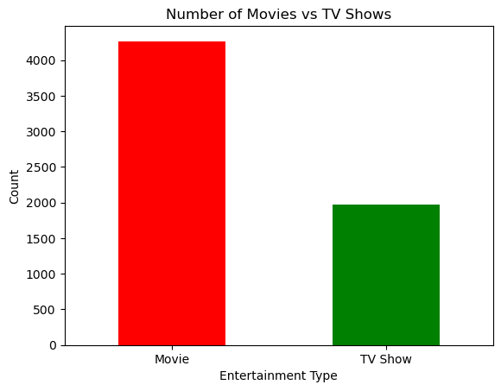
WHAT TYPE OF CONTENT IS AVAILABLE ON NETFLIX 68% of the content on Netflix is movies
4265
1969
There are more movie titles than tv show BY THE START OF 2020

Slide 8
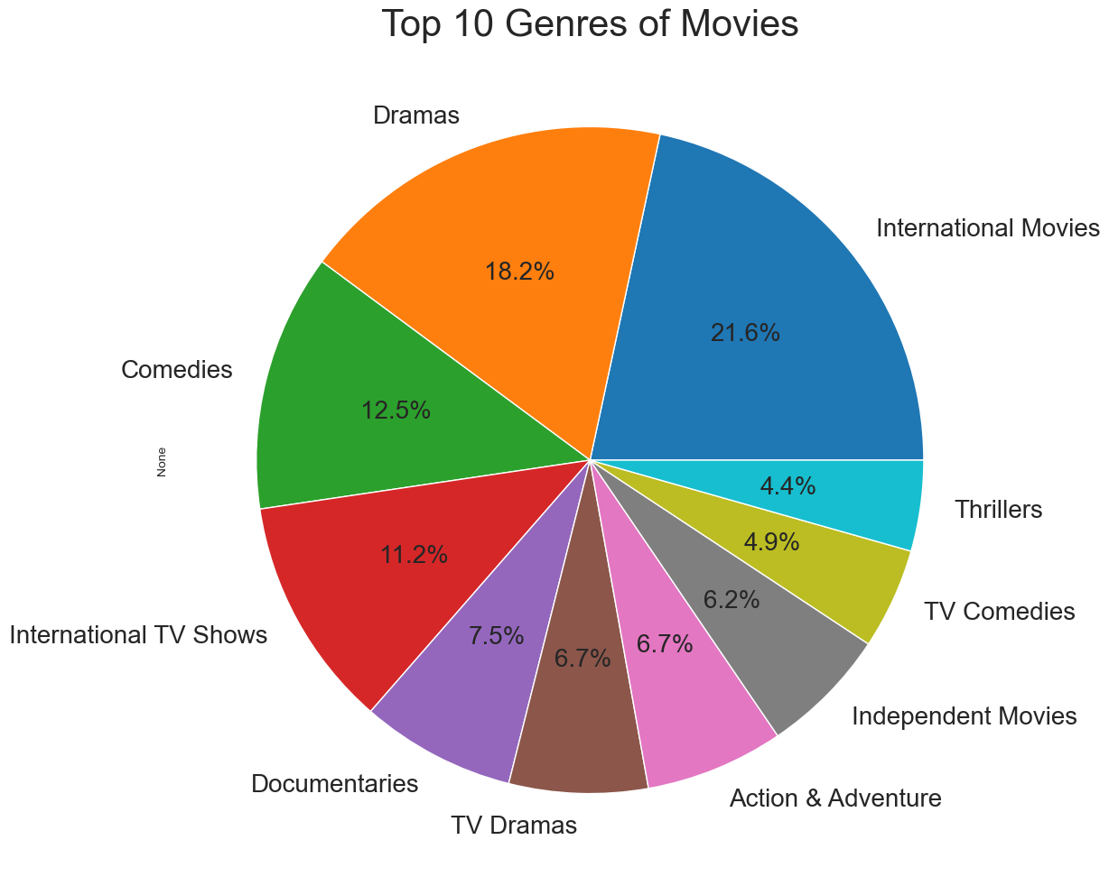
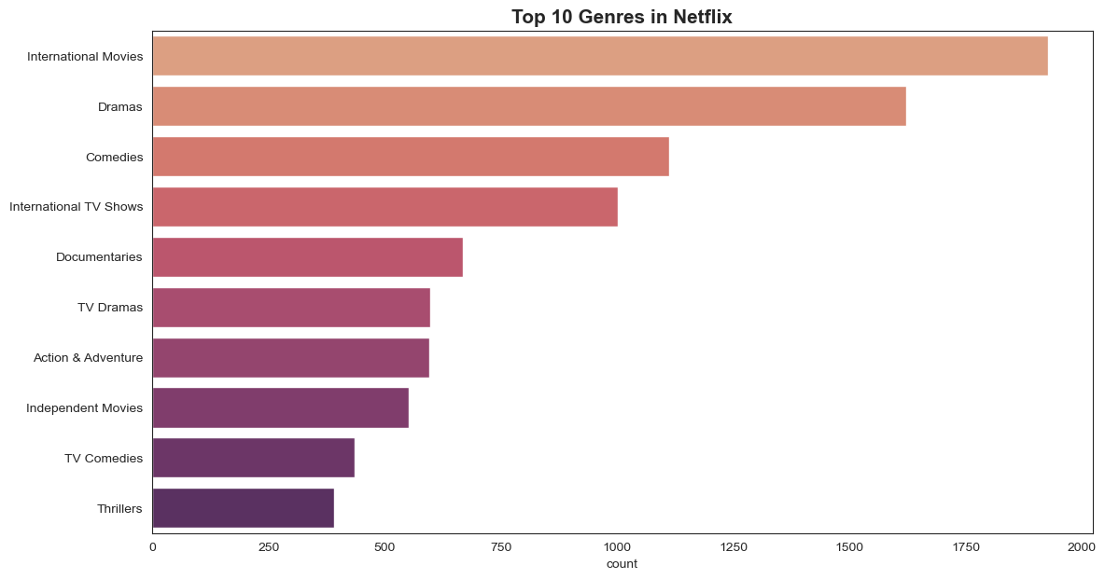
WHAT ARE THE MOST POPULAR GENRE ON NETFLIX - below are top 10 genre on Netflix; International movies is the topmost genre

Slide 9
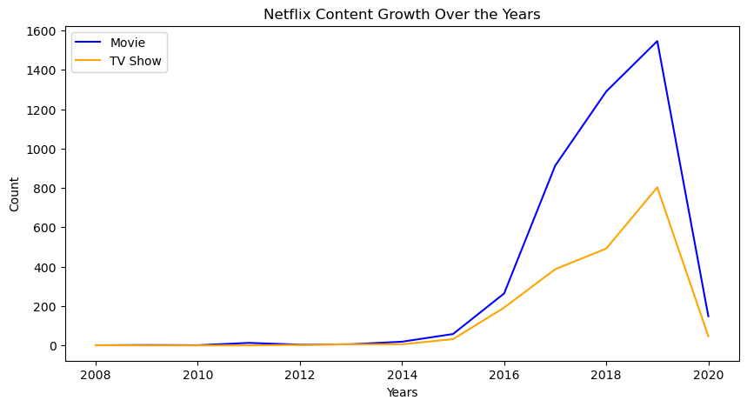
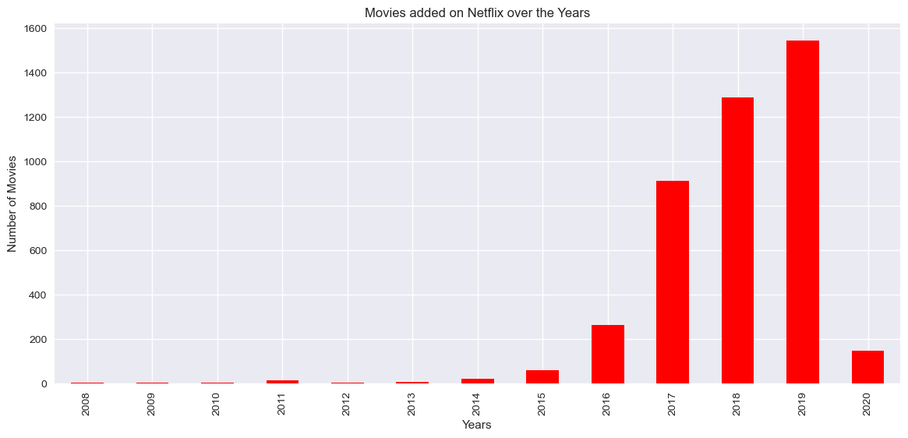
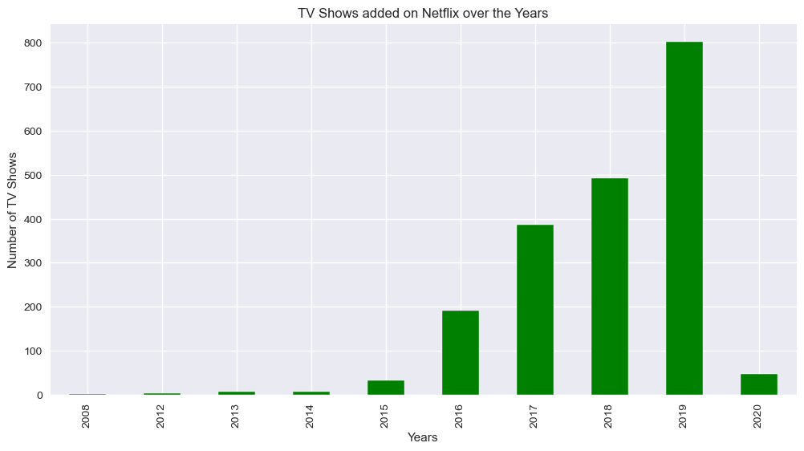
How has Netflix content grown over the years? There has been a steady growth of content on Netflix. However %age increase for tv shows is more than for movies which could indicate Netflix’s strategy to keep the audience engaged in longer-running content

Slide 10
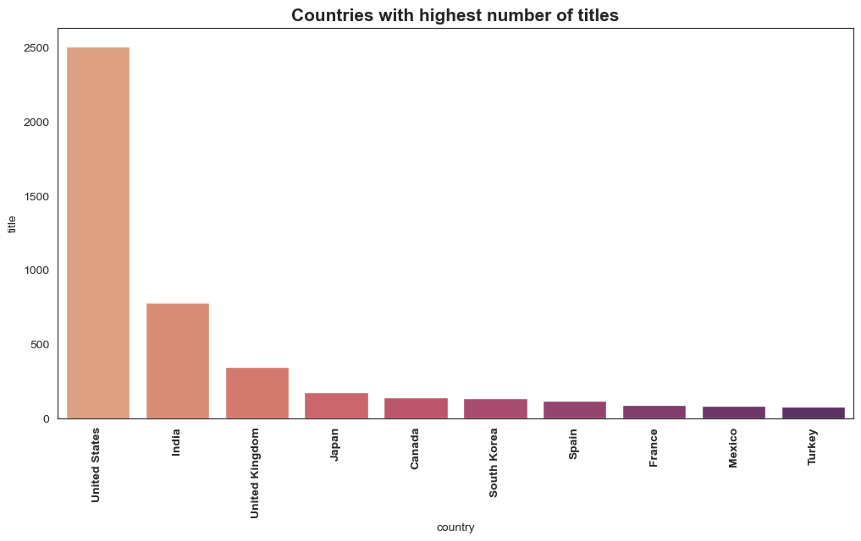
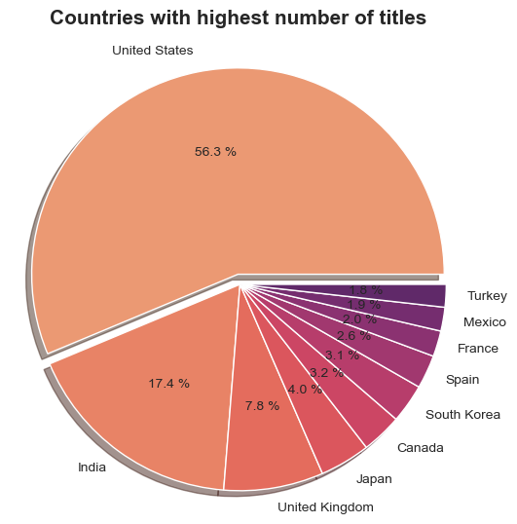
Which country has the highest number of titles on Netflix? 56% of the titles are available in the United States followed by India and UK.

Slide 11
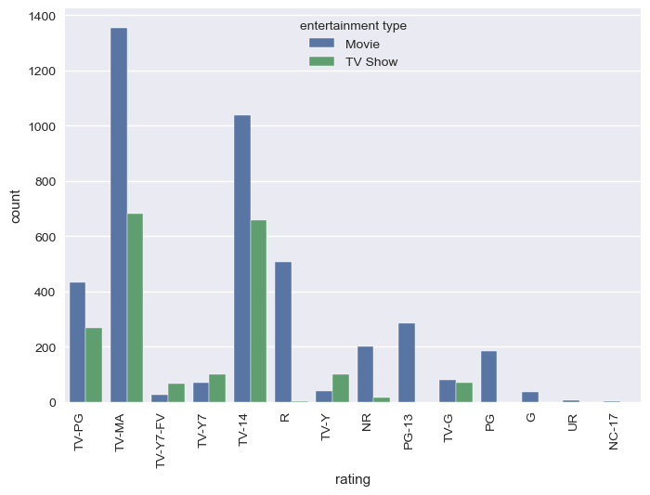
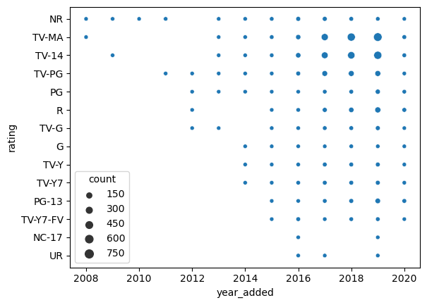
What are the most popular maturity rating on Netflix? Most of the movies available on Netflix are for a mature audience. The maximum number of titles is for Movies with tv ma ratings

Slide 12
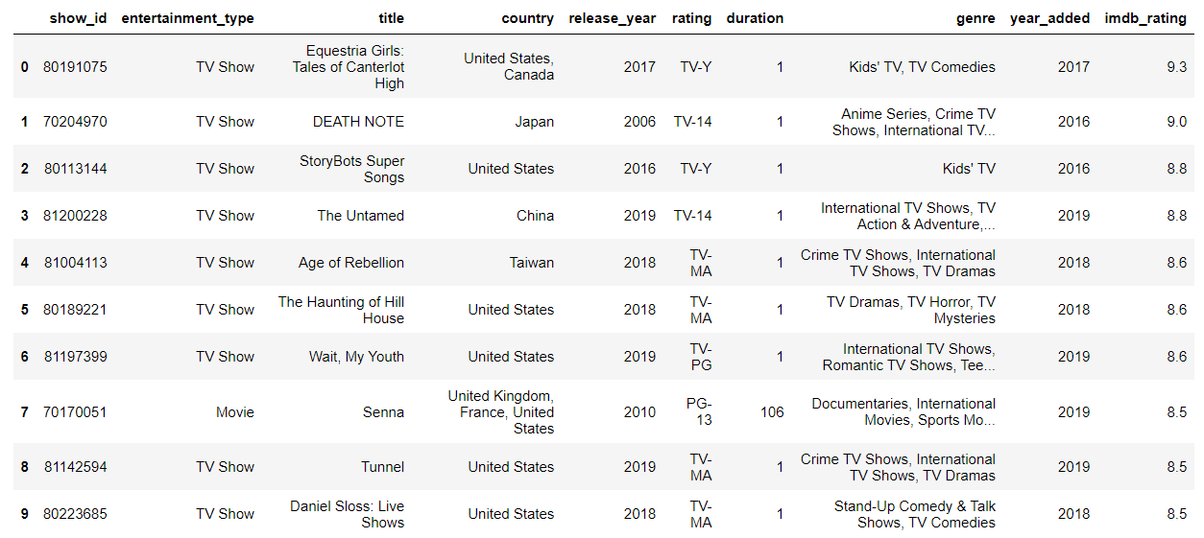
Top 10 highest-rated titles based on IMDb rating

Slide 13
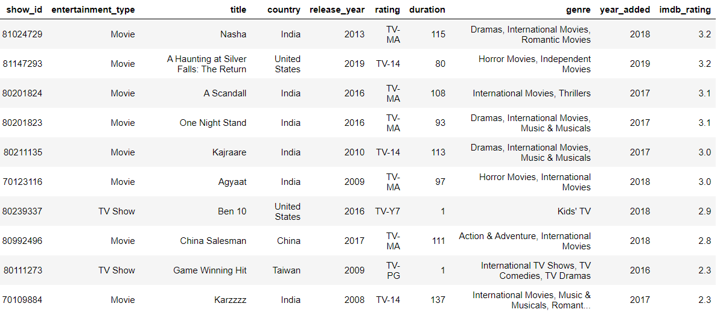
Lowest 10 rated titles based on imdb rating

Slide 14
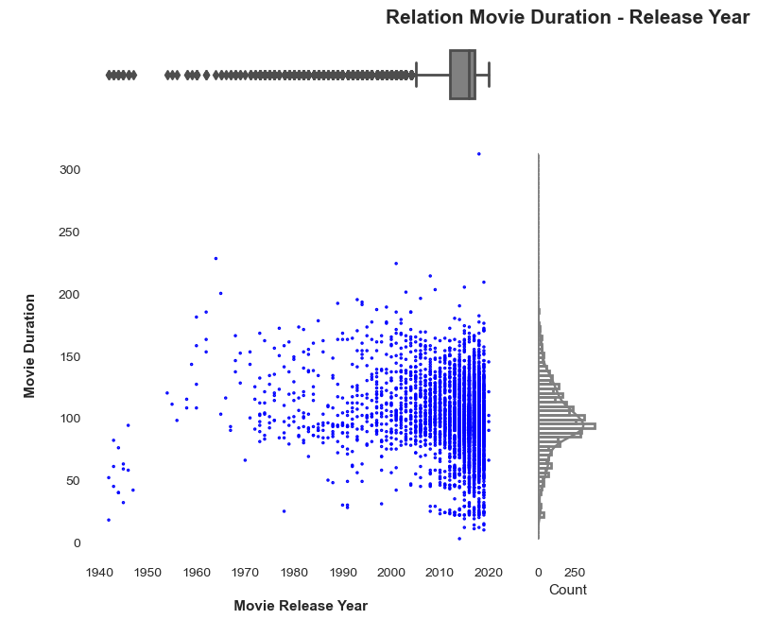
The average duration for all movies released on Netflix is ~ 99 minutes.

Slide 15
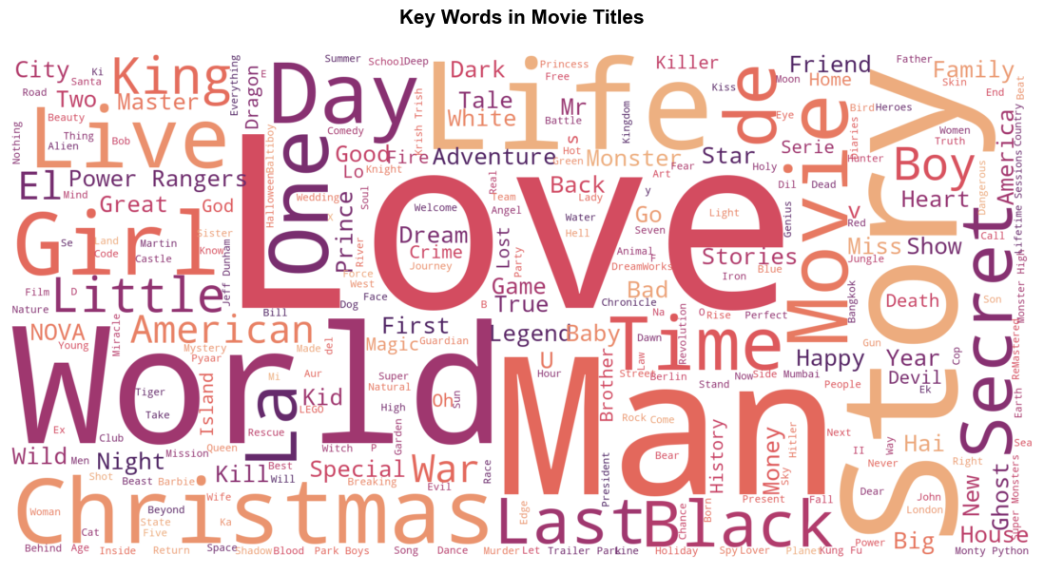
The most used words in Netflix titles are love, world and man.

Slide 16


Slide 17
FIN

